Slide 1


Problem Statement – LearnCraft

Slide 2
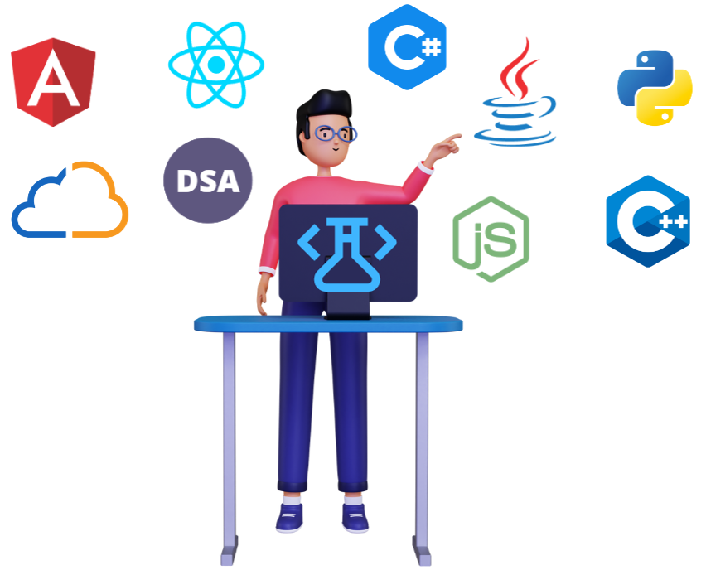
LearnCraft
Kata Topic
A technology education company aims to build a modern online learning portal that delivers high-quality video tutorials combined with live, hands-on labs.
Business Objectives:
Improve knowledge retention by combining theory (videos) with immediate hands-on practice.
Stand out by offering interactive, real-world labs instead of passive learning only.
Support a growing number of learners across regions without performance degradation.
Use AI-driven insights and assistance to keep learners motivated and on track.
Automate content support and learner guidance to reduce instructor and support overhead.
Ensure secure, isolated lab environments and protect learner data.

Slide 3

Context
Traditional learning platforms struggle to provide scalable, secure hands-on environments without high infrastructure costs or operational complexity.
The platform must support diverse learners—from beginners to advanced professionals—across multiple technologies and domains.
AI capabilities are essential to help learners quickly grasp concepts, navigate complex labs, and receive timely feedback without constant human intervention.
Modern learners expect more than recorded videos; they want interactive, practical experiences that closely mirror real-world scenarios.

Slide 4
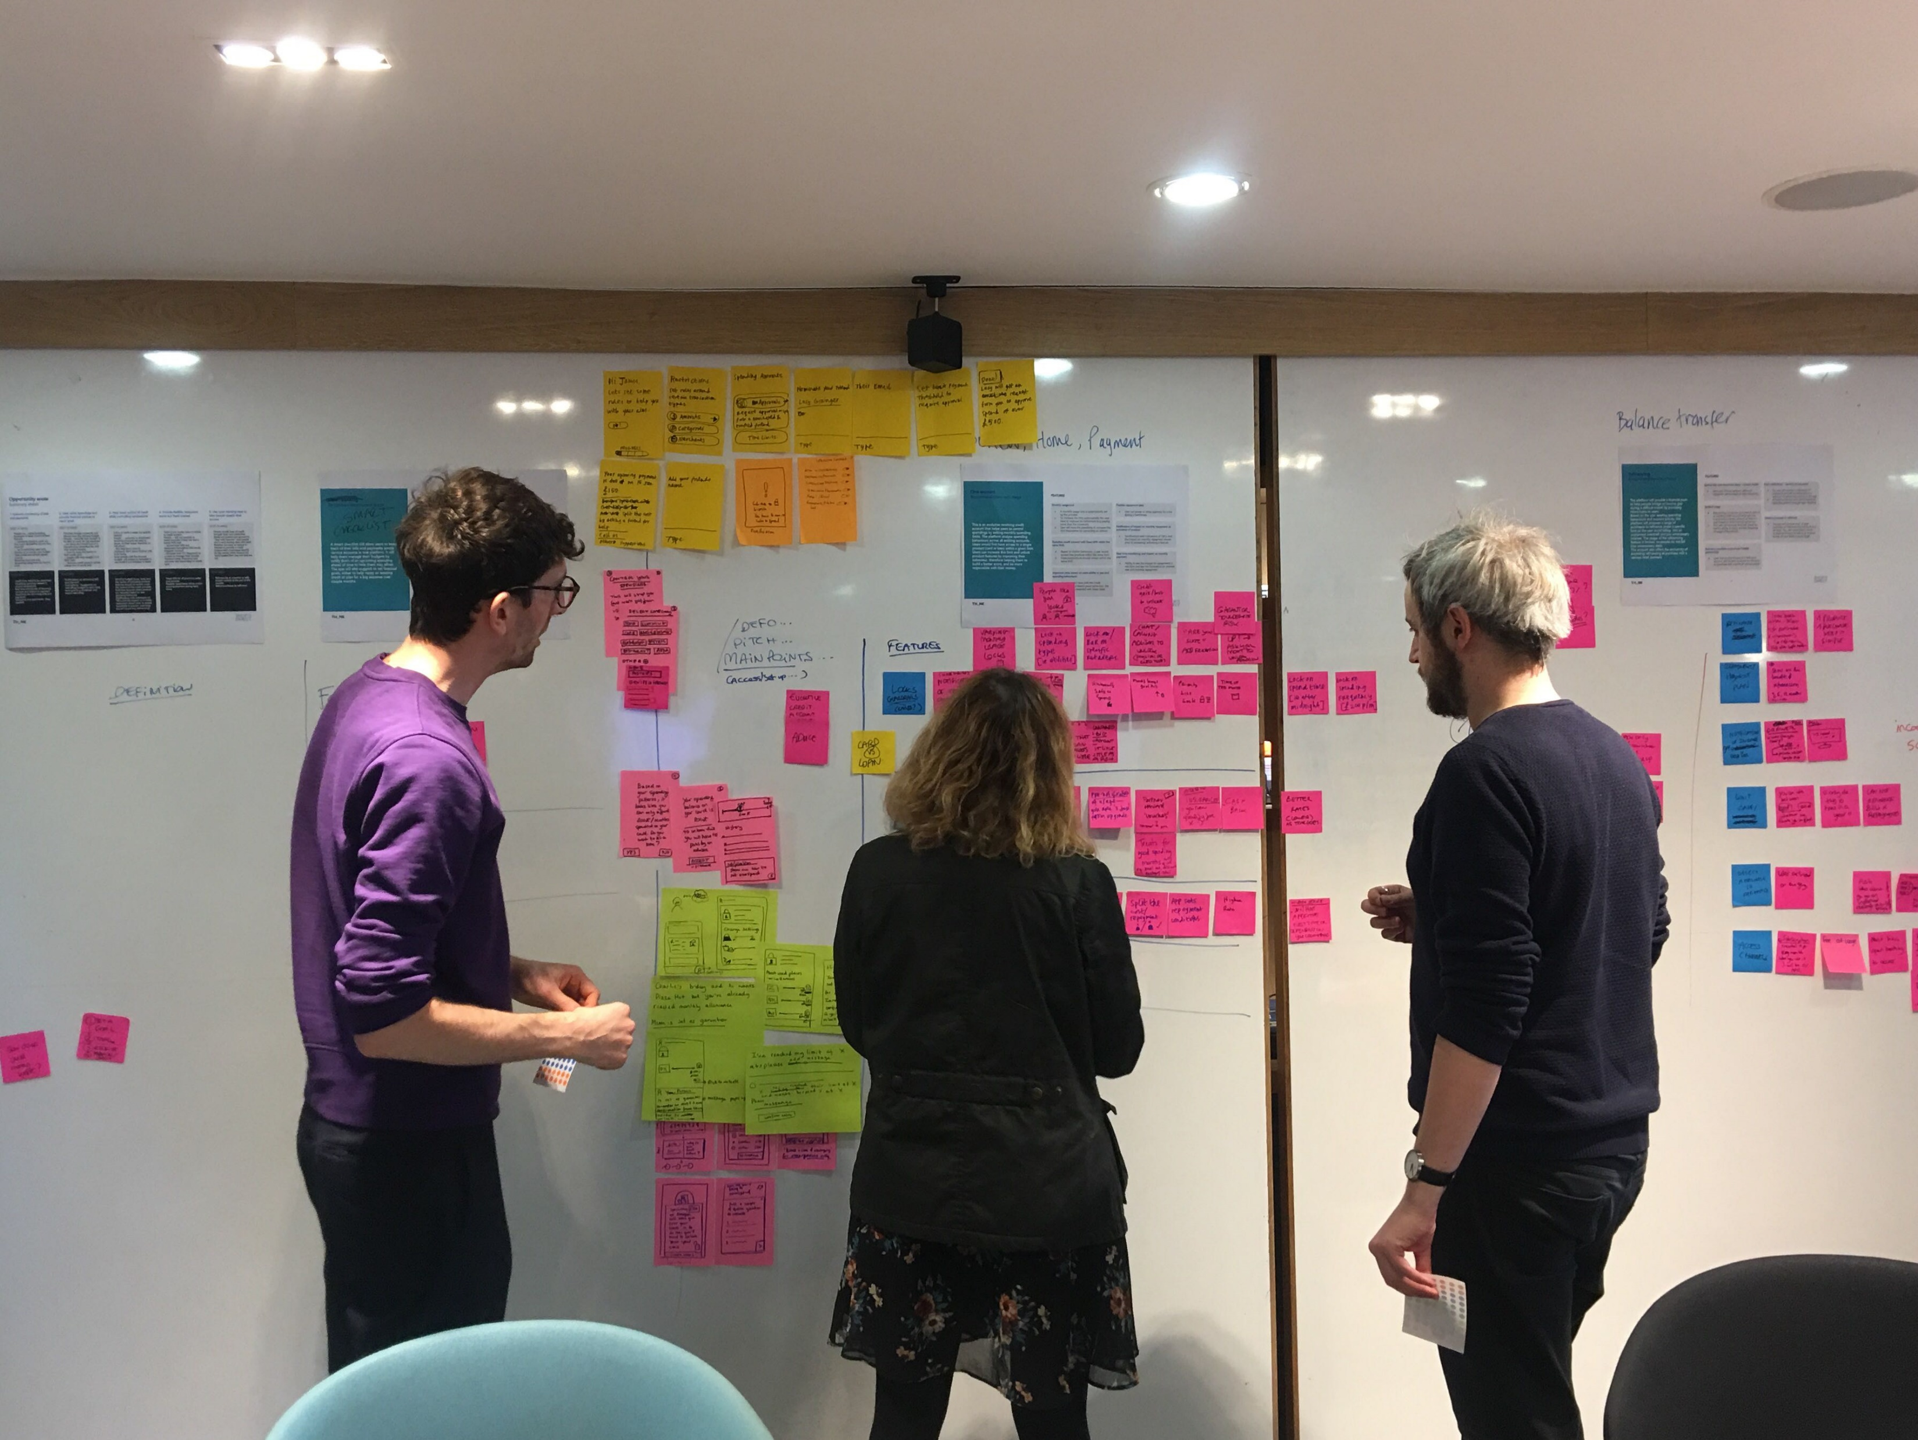
Key Requirements
Learning Content Delivery
  Host and stream video tutorials with support for structured courses, modules, and progress tracking.
  Enable AI-generated summaries of videos to help learners quickly revise key concepts.
Hands-On Lab Environment
  Provide on-demand, browser-based lab environments for practical exercises.
  Ensure labs are isolated, secure, time-bound, and resettable after each session.
  Support multiple technology stacks and toolchains.
AI-Driven Learning Assistance
  Generate summaries and key takeaways from lab activities and learner actions.
  Provide contextual hints, explanations, or troubleshooting guidance during labs.
  Offer personalized learning recommendations based on learner progress and behaviour.
Scalability & Reliability
  Handle high concurrent usage for videos and labs with predictable performance.
  Support rapid onboarding of new courses, labs, and users.
User Experience & Accessibility
  Deliver a consistent web-based experience across devices.
  Support multiple languages and regions as the platform grows.

Slide 5
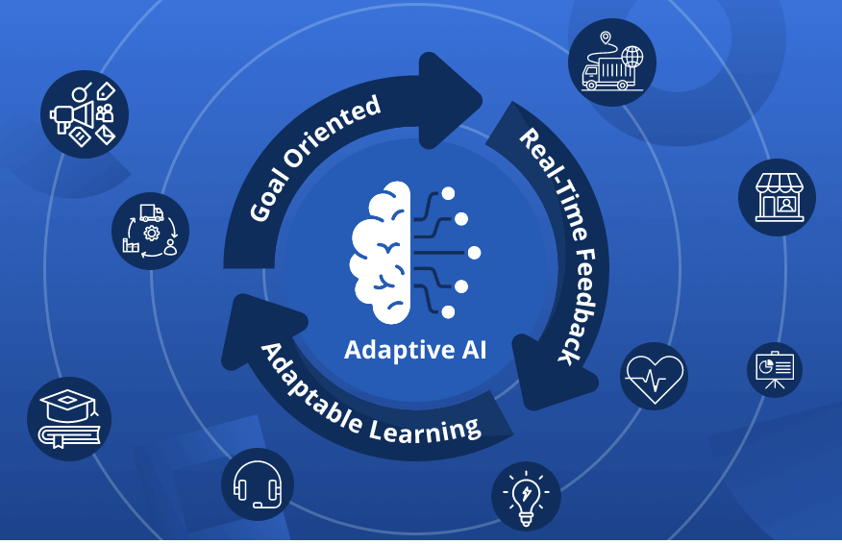
Nice To Have
Advanced AI Capabilities
  Conversational AI tutor to answer learner questions based on course and lab context.
  Auto-generate practice quizzes or challenges from video and lab content.
Instructor & Content Support
  AI-assisted content creation, including draft lab guides or video outlines.
  Analytics to identify where learners struggle most within videos or labs.
Collaboration & Community
  Enable peer discussions, shared lab sessions, or guided group labs.
  AI-moderated forums to surface high-quality answers and reduce noise.
Adaptive Learning Paths
  Dynamically adjust course recommendations based on learner goals, performance,
  and interests.
  Offer skill-level certifications or readiness indicators driven by lab performance.

Slide 6
Thank you!

